Slide 1
Attention Deficit Hyperactivity Disorder It’s not a disability, it’s a different ability!
Megan Welk 2/5
Causes:
The exact cause of ADHD is not known, although researchers continue to study the brain for clues. They suspect that there are several factors that may contribute to the condition, including:
Heredity: The fact that ADHD tends to run in families suggests that children may inherit a tendency to develop ADHD from their parents.
Chemical imbalance: Experts believe an imbalance of brain chemicals (neurotransmitters) that transmit nerve impulses may be a factor in the development of ADHD symptoms.
Brain changes: Areas of the brain that control attention are less active in children with ADHD than in children without ADHD.
Definition:
ADHD is a common condition that affects children and adolescents and can continue into adulthood for some.
Children with ADHD generally have problems paying attention or concentrating. They can't seem to follow directions and are easily bored or frustrated with tasks. They also tend to move constantly and are impulsive, not stopping to think before they act. These behaviors are generally common in children. But they occur more often than usual and are more severe in a child with ADHD.
These behaviors don’t just interfere with the child’s ability to function at school, they also interfere with their life at home.
In adults:
Adults with ADHD may have difficulty with time management, organizational skills, goal setting, and employment. They may also have problems with relationships, self-esteem, and addictions.
Symptoms:
Inattention: May not become noticeable until the child is in a difficult situation or challenging environment.
Difficulty paying attention to details and tendency to make careless mistakes in school or other activities
Easily distracted and frequently interrupting ongoing tasks
Inability to sustain attention on tasks or activities
Difficulty finishing schoolwork or paperwork or performing tasks that require concentration
Frequent shifts from one uncompleted activity to another
Procrastination
Disorganized work habits
Forgetfulness in daily
Failure to complete tasks such as homework or chores
Frequent shifts in conversation, not listening to others, not keeping one's mind on conversations, and not following details or rules of activities in social situations
Hyperactivity: Shown in very young children (preschoolers) and are always present before the child is seven years old.
Fidgeting, squirming when seated
Getting up frequently to walk or run around
Running or climbing excessively when it's inappropriate (in teens this may appear as restlessness)
Having difficulty playing quietly or engaging in quiet leisure activities
Always being 'on the go'
Often talking excessively
Impulsivity:
Impatience
Difficulty delaying responses
Blurting out answers before questions have been completed
Difficulty awaiting one's turn
Frequently interrupting or intruding on others to the point of causing problems in social or work settings
Initiating conversations at inappropriate times
Prevalence:
This condition is characterized by inattention, hyperactivity and impulsiveness.
1.5 Million to 3.5 Million in the US
These symptoms continue into adulthood for about 60% of children with ADHD.
That translates into 4% of the U.S. adult population, or 8 million adults.
Few adults are identified or treated for adult ADHD.

Slide 2
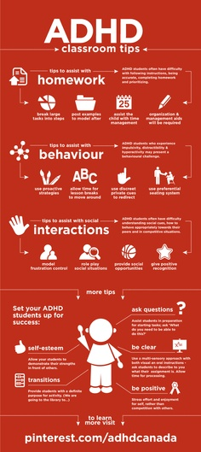
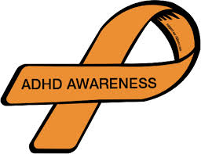
Assistive Technology:
Clickers: Remote controls that record students answers. It engages the student.
iPads: Visual, hands on and can be auditory. So many apps that can support the child.
SmartBoards: Great way to provide engaging lessons and differentiated instruction.
Non-technological Assistive Technology:
Highlighters
Timers
Stress Balls
Graphic Organizers
Sticky Notes
Treatment:
Medication therapy is an important component of treating ADHD. There are many types of drugs that can be used to control symptoms of ADHD.
ADHD medications are available in short-acting (immediate-release), intermediate-acting, and long-acting forms. It may take some time for a doctor to find the most effective drug, dosage, and schedule for someone with ADHD.
Side Effects:
Decreased appetite/weight loss
Sleep problems
Headaches
Jitteriness
Information and Support:
There are a lot of websites and forums where parents can talk to one another and share information.
www.webmd.com has a lot of information for parents who are still becoming familiar with ADHD.

